Slide 1
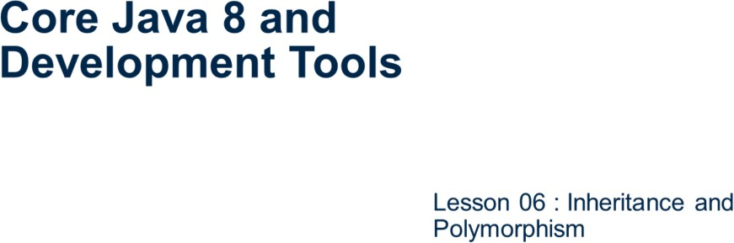
Core Java 8 and Development Tools
Inheritance and Polymorphism

Slide 2
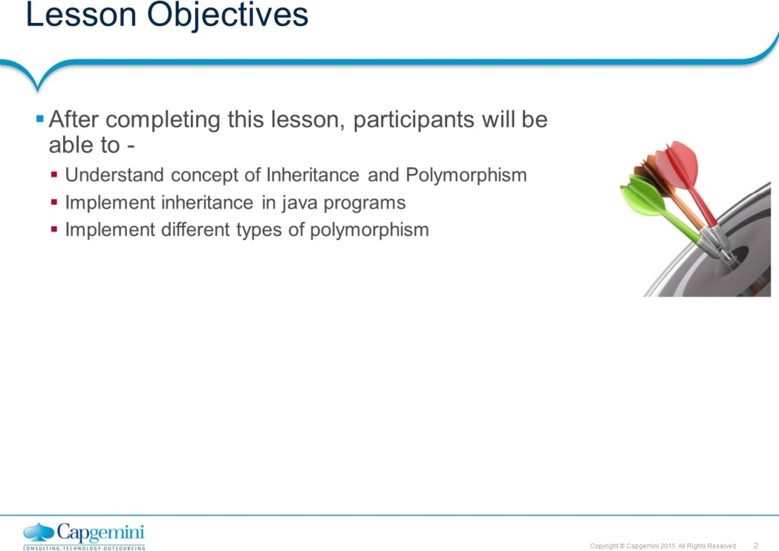
Core Java 8 and Development Tools
Inheritance and Polymorphism
Outline:
Lesson 6: Inheritance and Polymorphism 6.1: Inheritance
6.2: Using super keyword 6.3: InstanceOf Operator
: Method & Constructor overloading
: Method overriding
: @override annotation 6.7: Using final keyword 6.8: Best Practices

Slide 3
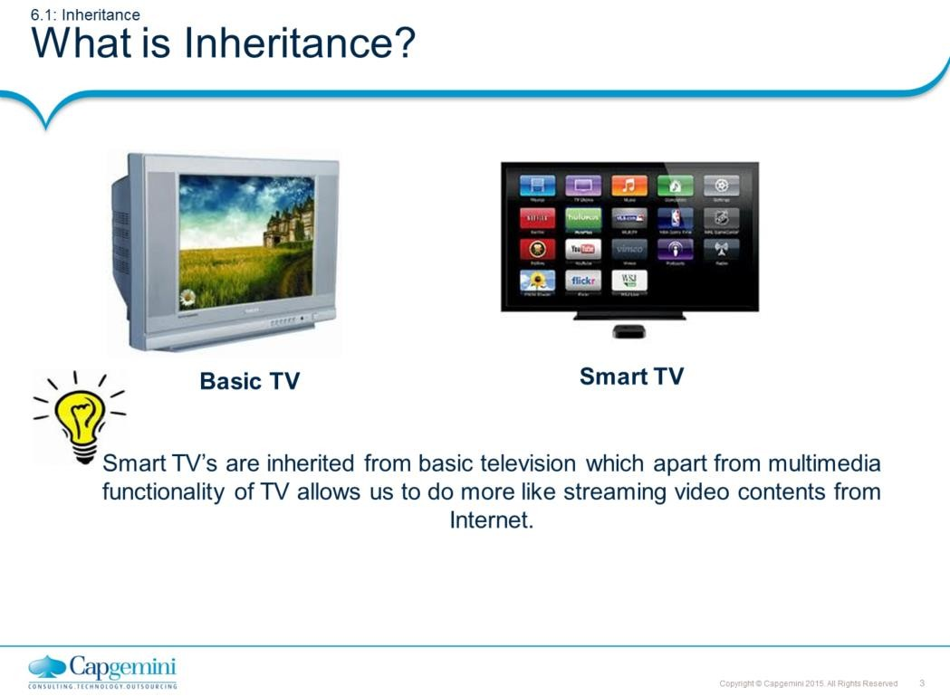
Core Java 8 and Development Tools
Inheritance and Polymorphism
What is Inheritance?
If you look at the slide example of how televisions are evolved in last decade, you will find two major differences between these two models. Basic TV’s are used to watch programs typically they are streamed from set top box. On the other hand, the most advanced "smart TVs" are similar in function to "smart phones" and some tablets. These TVs go beyond providing access to web-based media, or streaming from content stored on your home computer. Smart TVs have the built in computing power that allows you to do many of the same things you can do with a smart phone or tablet such as web browsing, use of web-based services like Skype, and interactive access to social media sites.
Apart from the functional enhancement, there is slight alteration from hardware point of view. The position of sound boxes is altered and in smart TV’s like to hide them from front view.
Smart TV’s are “inherited” from Basic TV for two reasons:
To make enhancement and/or
To do alteration
This is basis of inheritance in OOPs where one class we can extend to either enhance its functionality or alter its behavior.

Slide 4
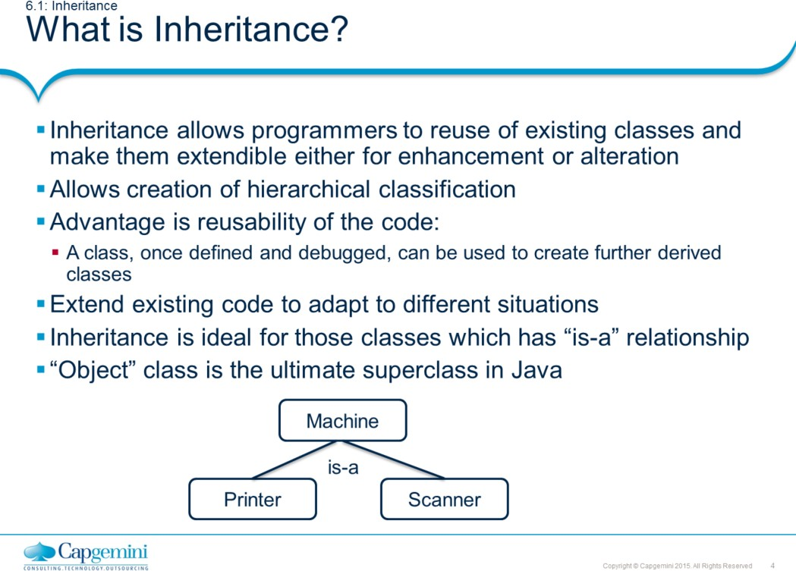
Core Java 8 and Development Tools
Inheritance and Polymorphism
It is one of the fundamental mechanisms for code reuse in object-oriented programming. Inheritance allows new classes to be derived from existing classes. In Java, inheritance specifies how different is the sub class from its parent class. Thus, we can add new variables, methods and also modify the inherited methods. To inherit a class, you simply extend the super class into the subclass. Only single level inheritance is possible in Java.
Superclass and Subclass:
Any class preceding a specific class in the class hierarchy is said to be super class. On the other hand Any class following specific class in the hierarchy is called as subclass. All classes in Java are by default extensible. All All Java classes that do not explicitly extend a parent class automatically extend
the java.lang.Object class.
Object
Class X Class Y
In the above example, class Y is subclass. Class X is superclass of Y but subclass
of Object class. Object class is the ultimate superclass in Java.

Slide 5
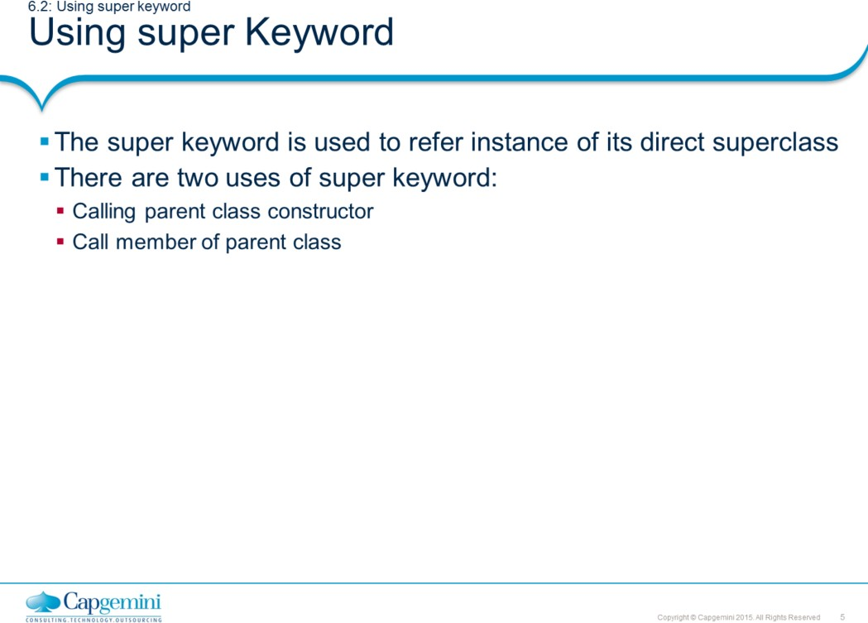
Core Java 8 and Development Tools
Inheritance and Polymorphism
When you create instance of child class by calling its one of the constructor, it invokes immediate parent class default constructor which in turn calls its parent- parent class constructor. This process continues until constructor of Object class is called.
This constructor call chain will break if there is no default constructor available on parent class. To avoid this, you can call non-default constructor of parent class by using super keyword.
Kindly note when you call parent class constructor using super keyword, it must be written as first line of child constructor.
The other use of super keyword is to call to access the members of parent class. The member can be accessed by using syntax super.memberName or super.memeberMethod().

Slide 6
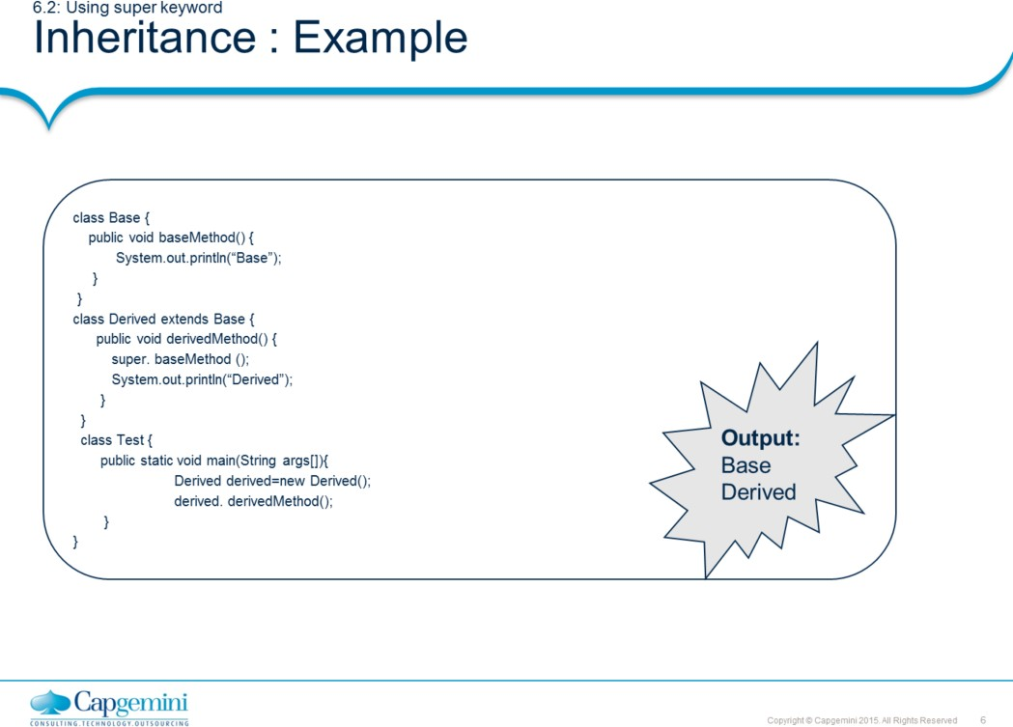
Core Java 8 and Development Tools
Inheritance and Polymorphism

Slide 7
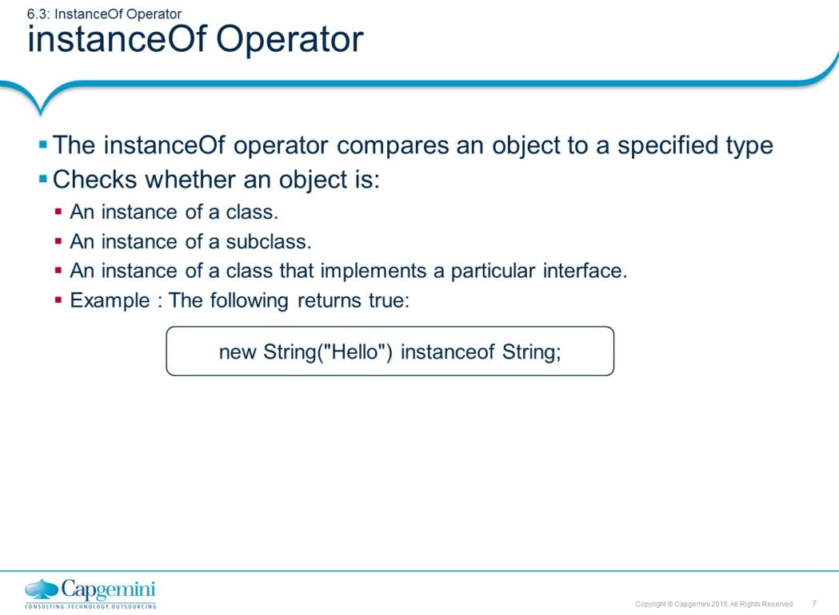
Core Java 8 and Development Tools
Inheritance and Polymorphism
The instanceof operator is used to make a test whether the given object belongs to specified type. Consider the below example. The if statement returns true here as the child object is type of its superclass.
class Ticket{
}
class ConfirmedTicket extends Ticket {
}
…
…
ConfirmedTicket tkt= new ConfirmedTicket(); If(tkt instanceof Ticket) {
//some processing
}

Slide 8
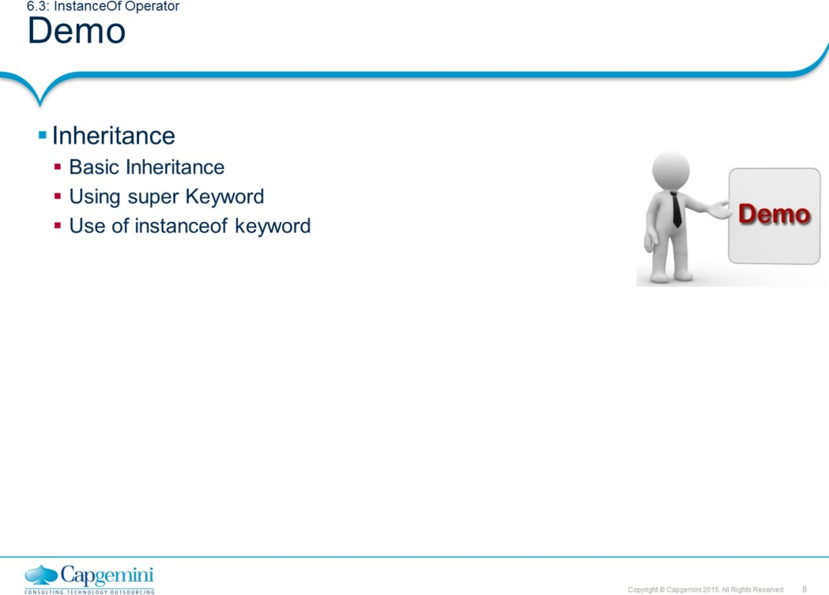
Core Java 8 and Development Tools
Inheritance and Polymorphism

Slide 9
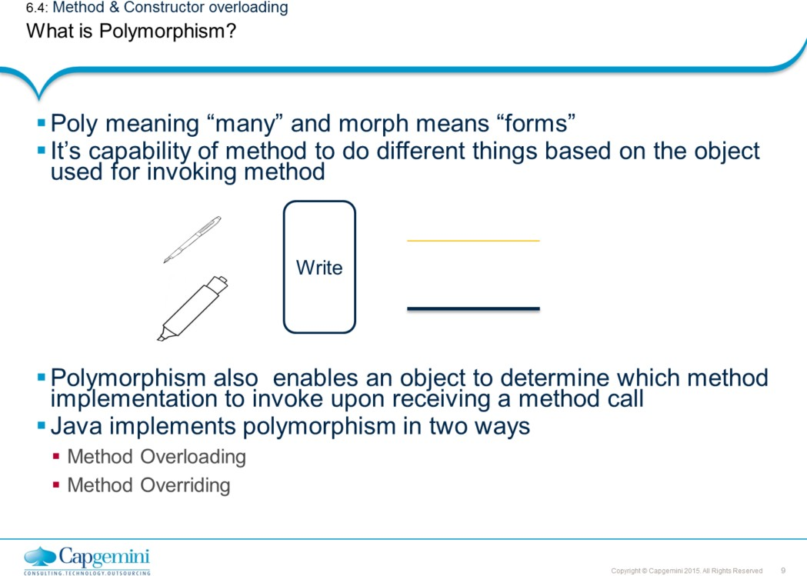
Core Java 8 and Development Tools
Inheritance and Polymorphism
There are two ways in which polymorphism is implemented in Java.
Method Overloading
Method Overriding
Method Overloading is compile time polymorphism where the same method name has different meanings. Method overriding on other hand, is kind of runtime polymorphism where a subclass defines method with the same signature as defined by its superclass.

Slide 10
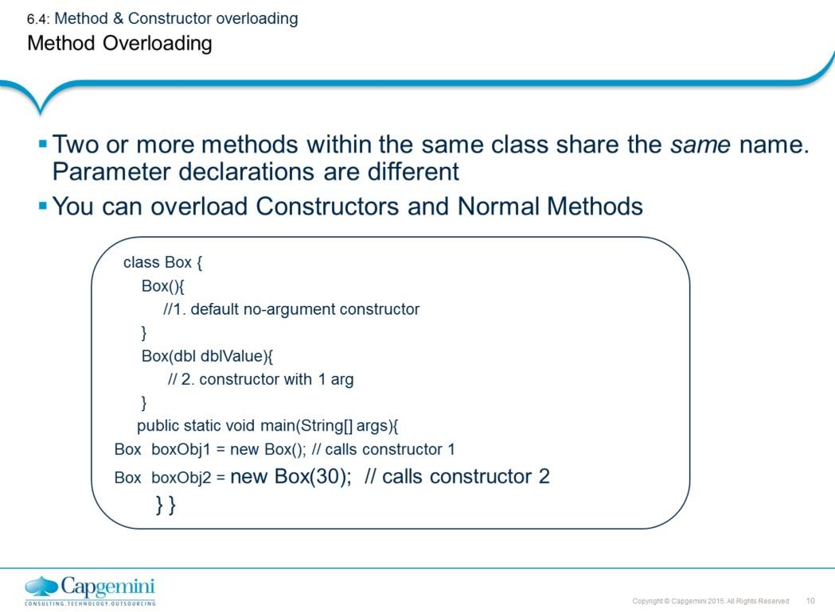
Core Java 8 and Development Tools
Inheritance and Polymorphism
In Java it is possible to define two or more methods within the same class that share the same name, as long as their parameter declarations are different. Here, the methods are said to be overloaded. When an overloaded method is invoked, Java determines which method to actually call by using the type and/or number of operators as its guide.
Refer the example above. Here, two constructors have been declared; one with no
arguments, the second with a single argument
Note: In addition to overloading constructors, you can also overload normal methods.

Slide 11
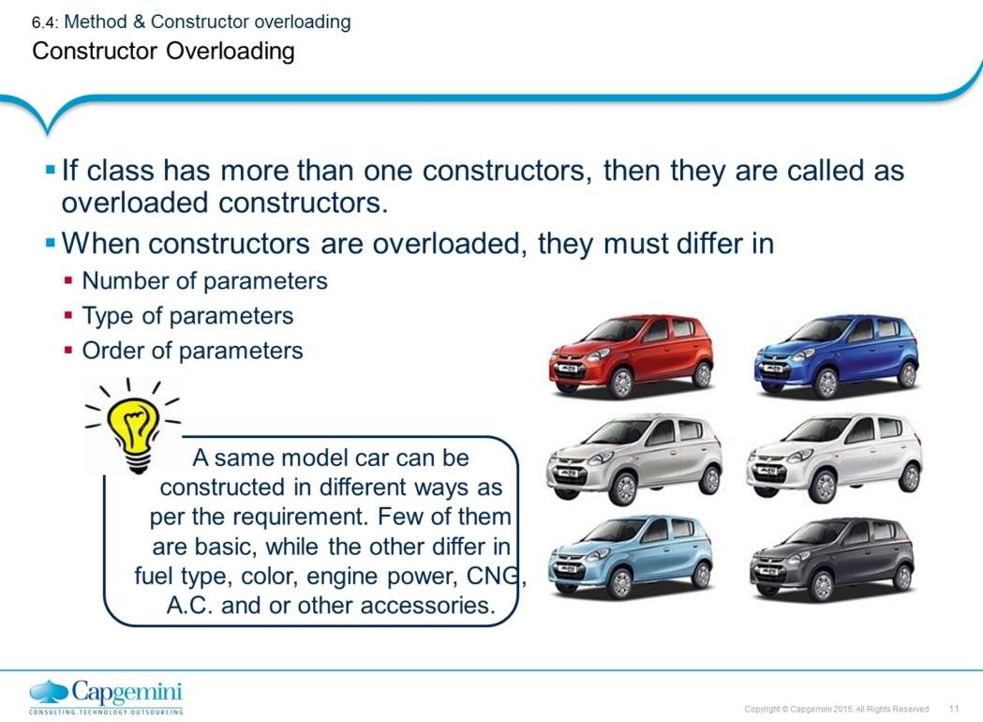
Core Java 8 and Development Tools
Inheritance and Polymorphism
Example:
class Car {
int noOfCylinders; int noOfValves; int enginePower;
boolean isPowerSteering;
Car(){
//1. default no-argument constructor noOfCylinders = 3;
noOfValves = 4;
enginePower = 48; //48 ps isPowerSteering = false;
}
Car(boolean isPowerSteering){
// 2. constructor with 1 arg this();
this.isPowerSteering = isPowerSteering;
}
Car(int enginePower,int noOfCylinders, int noOfValves){
// 3. constructor with // 3 args this.noOfCylinders = noOfCylinders; this.noOfValves = noOfValves ; this.enginePower = enginePower; this.isPowerSteering = true;
}
}

Slide 12
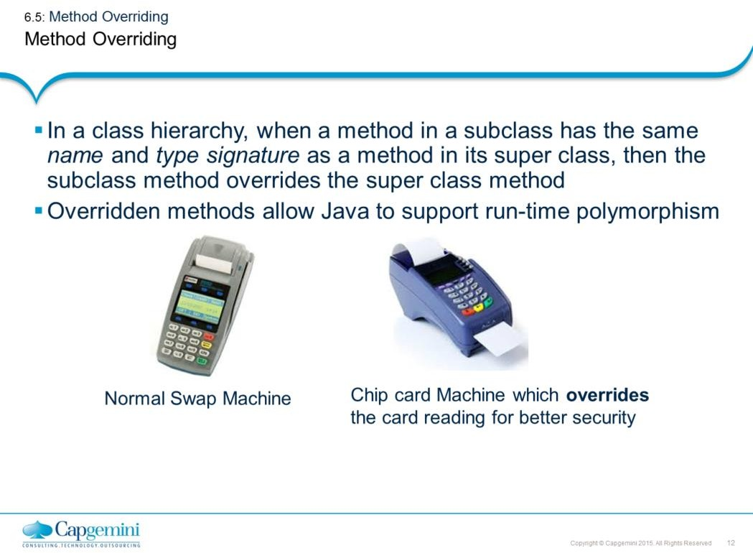
Core Java 8 and Development Tools
Inheritance and Polymorphism
Example:
class SwipeMachine{ void readCard (){
// functionality to read normal cards
}
}
class ChipCardMachine extends SwipeMachine{ void readCard(){
//functionality to read chip card
}
}
public static void main(String args[]){ SwipeMachine normal = new SwipeMachine();
normal.readCard(); //reading normal swipe card normal = new ChipCardMachine();
normal.readCard(); //reading chip based swipe card
} }

Slide 13
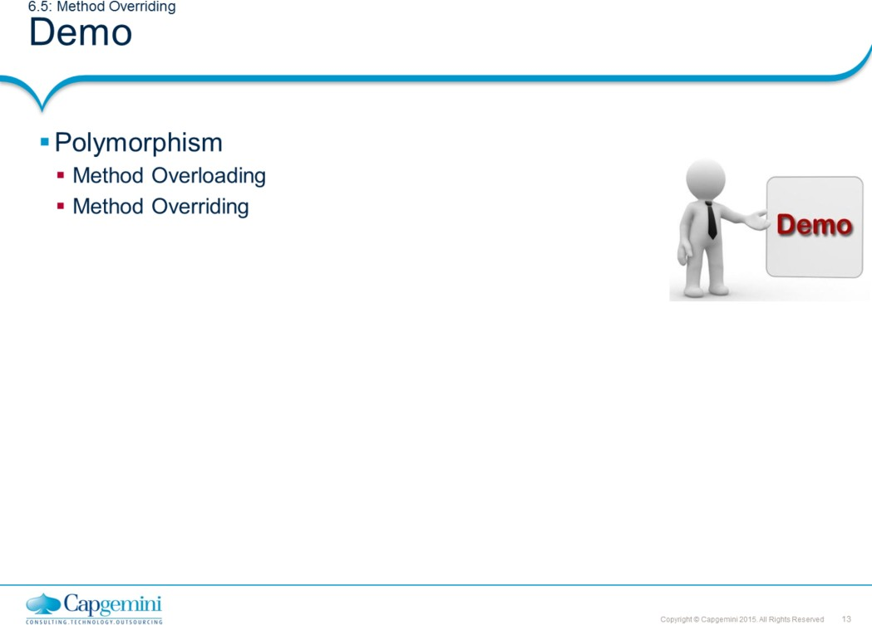
Core Java 8 and Development Tools
Inheritance and Polymorphism

Slide 14
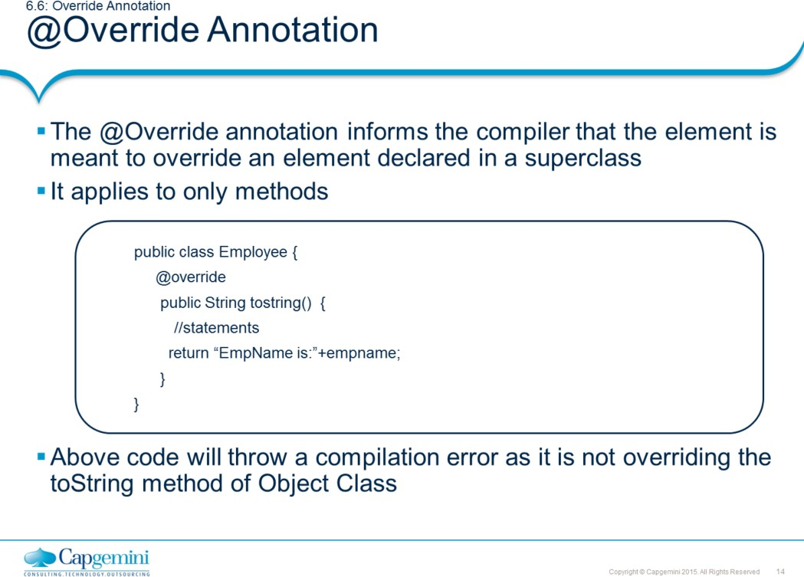
Core Java 8 and Development Tools
Inheritance and Polymorphism
@Override:
The Compiler checks that a method with this annotation really overrides a method from the Super class or not
While it's not required to use this annotation while overriding a method, it helps to prevent errors. If a method marked with @Override fails to correctly override a method in one of its superclasses, the compiler generates an error.
Most commonly, it is useful when a method in the base class is changed to have a different parameter list. A method in a subclass that used to override the superclass method no longer does so due to the changed method signature. This can sometimes cause strange and unexpected behavior, especially while dealing with complex inheritance structures. The @Override annotation safeguards against this. @Override is useful in detecting changes in parent classes which has not been reported down the hierarchy. Without it, a method signature can be changed and altering its overrides can be forgotten. With @Override, the compiler catches it for you.
Other annotations supported in Java SE:
The @SuppressWarnings annotation instructs the compiler to suppress the warning messages it normally shows during compilation time.
@Deprecated marks an old method as deprecated. Which says this method must not be used anymore because in the future versions, this old method may not be supported.

Slide 15
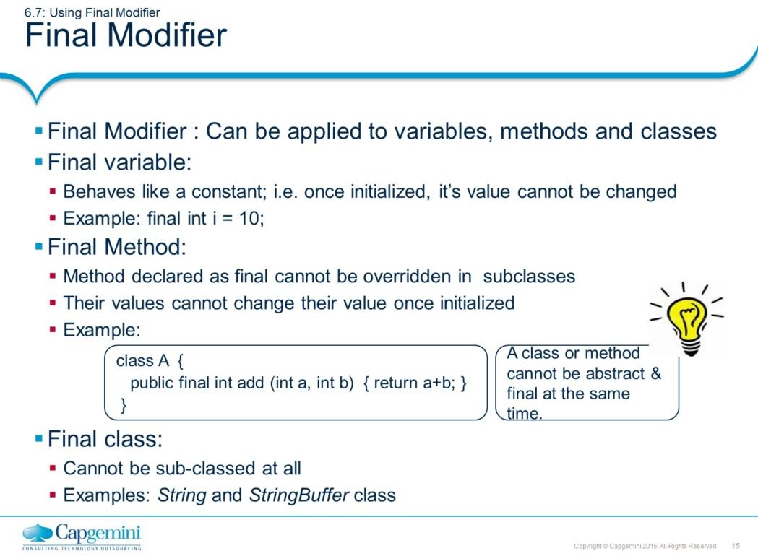
Core Java 8 and Development Tools
Inheritance and Polymorphism

Slide 16
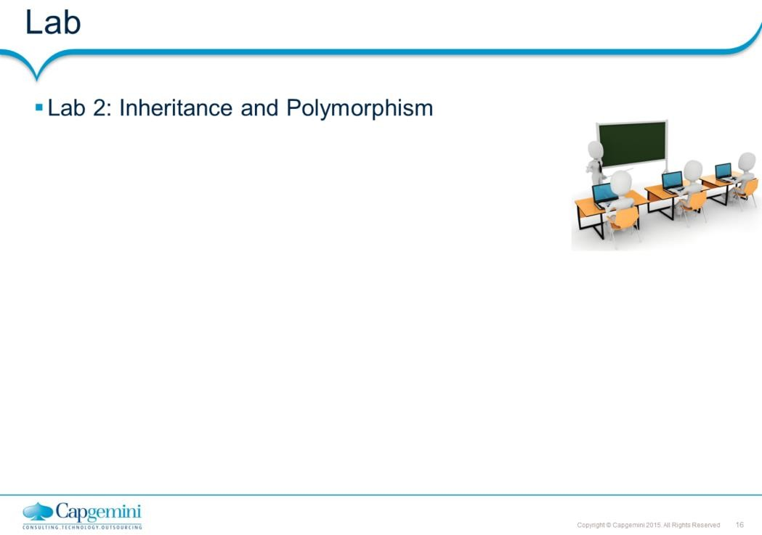
Core Java 8 and Development Tools
Inheritance and Polymorphism

Slide 17
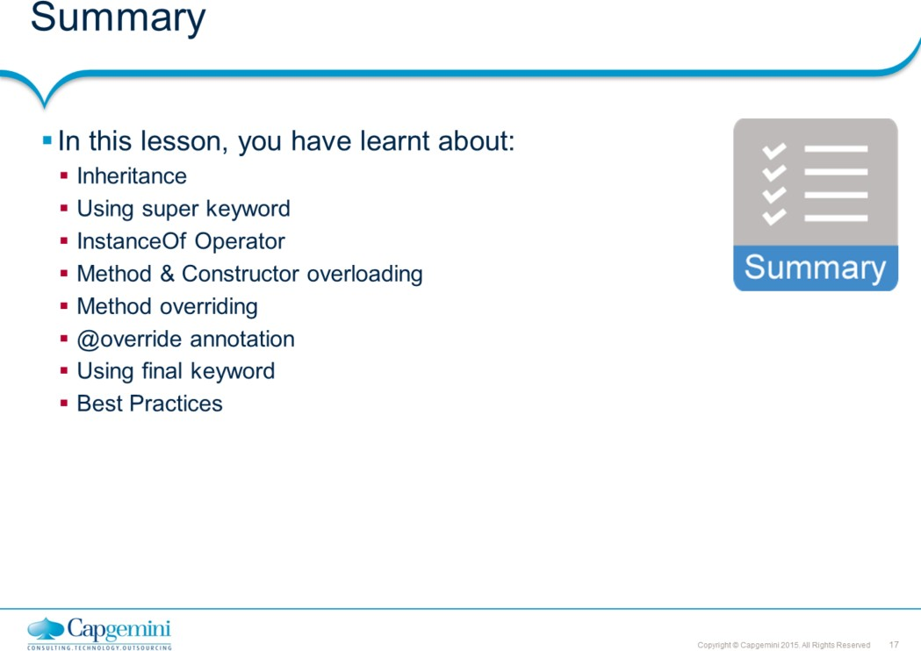
Core Java 8 and Development Tools
Inheritance and Polymorphism

Slide 18
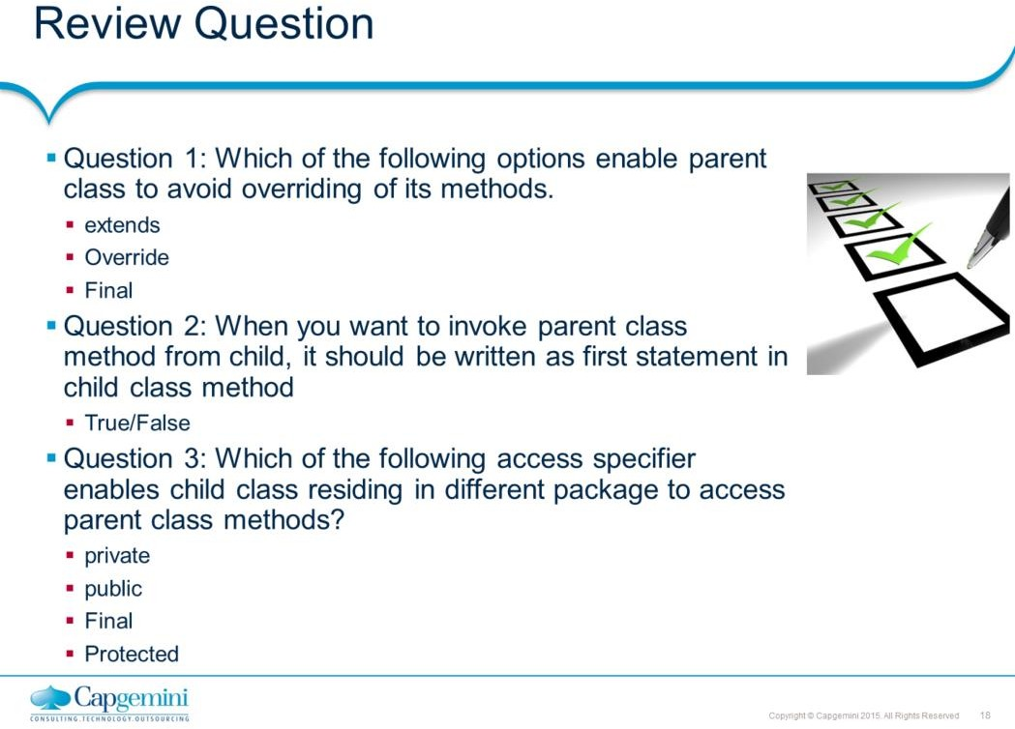
Core Java 8 and Development Tools
Inheritance and Polymorphism

